Slide 1


Hassan Sulaiman
18-02-24

Slide 2

Outline
Executive Summary
Introduction
Methodology
Results
Conclusion
Appendix

Slide 3
Executive Summary
Summary of Methodologies:
Utilized SpaceX's public data for comprehensive analysis.
Employed data wrangling techniques for data cleanliness and preparation.
Conducted exploratory data analysis (EDA) with statistical and visual tools.
Implemented interactive visual analytics using Folium and Plotly Dash.
Applied classification models for predictive analysis.
Optimized models using hyperparameter tuning and cross-validation.
Summary of All Results:
Identified key patterns and insights from launch site proximities and success rates.
Successfully marked and analyzed launch outcomes on an interactive map.
Determined the payload range with the highest success rate for launches.
Found the F9 Booster version with the highest launch success rate.
Achieved prediction of first-stage landing with high accuracy using machine learning.
Developed a dashboard that enables real-time interactive analysis of SpaceX launch data.

Slide 4
Introduction
The commercial space age has arrived with companies like SpaceX leading the way.
SpaceX's achievements include ISS missions, the Starlink project, and manned flights.
Their Falcon 9 rocket launch costs are lower due to reusable stages.
Predicting first-stage landings is key to determining launch costs.
Using 3D visuals, we'll understand the Falcon 9's design and cost implications.
As Space Y's data scientist, I aim to shape our pricing strategy using SpaceX's data.
We'll use machine learning, not rocket science, to predict stage reusability.
We'll navigate through data-driven strategies for competitive space travel pricing.

Slide 5

Section 1

Slide 6
Methodology
Executive Summary
Data collection methodology:
Comprehensive data sourcing
Validation of data accuracy and integrity
Data Wrangling
Data cleansing and formatting
Addressing missing values and inconsistencies
Exploratory Data Analysis (EDA)
Data visualization
SQL-based data querying
Interactive Visual Analytics
Geospatial analysis with Folium
Interactive web-based dashboard creation with Plotly Dash
Predictive Analysis
Classification model development
Model tuning and evaluation

Slide 7
Data Collection
Overview:
Data sets were systematically gathered utilizing the SpaceX REST API and web scraping techniques, ensuring a comprehensive dataset ready for extensive analysis.
Data Collection Process
Identify data requirements
Select appropriate data sources
Retrieve data using API calls
Scrape data from web sources
Compile initial dataset

Slide 8
Data Collection – SpaceX API
SpaceX API:
Data was meticulously collected using the SpaceX API, providing detailed information about rocket launches, payloads, and landing outcomes.
Data Collection Process with SpaceX REST Calls:
Access SpaceX REST API endpoints
Perform GET requests for launch data
Extract JSON formatted results
Normalize JSON data into flat tables
GitHub URL

Slide 9
Data Collection - Scraping
Scraping:
Web scraping was employed to complement API data, extracting valuable launch records from designated Wikipedia web pages.
Data Collection Process with Web Scraping:
Identify target web pages with launch data
Utilize BeautifulSoup to parse HTML content
Extract relevant table data
Convert HTML tables to DataFrame format
GitHub URL

Slide 10
Data Wrangling
Data Wrangling:
Data was processed through rigorous cleansing, transformation, and enrichment steps to ensure analysis-readiness.
Data Wrangling Process
Filter Falcon 9 specific data
Fetch additional details via API for IDs
Cleanse and impute missing values
Standardize and encode categorical variables
Prepare final analytic-ready dataset
GitHub URL

Slide 11
EDA with Data Visualization
The following charts were plotted as part of the exploratory data analysis:
Scatter Plot (Flight Number vs. Payload Mass):
Indicates the impact of flight experience and payload size on launch success.
Categorical Plot (Flight Number vs. Launch Site):
Shows the launch success rate distribution across different sites.
Scatter Plot (Payload vs. Launch Site):
Explores the relationship between payload mass and preferred launch sites.
Bar Chart (Success Rate by Orbit Type):
Compares success rates across various orbit types.
Scatter Plot (Flight Number vs. Orbit Type):
Analyzes flight experience correlation with success in specific orbits.
Scatter Plot (Payload vs. Orbit Type):
Assesses how payload mass influences success rates in different orbits.
Line Chart (Launch Success Yearly Trend):
Tracks changes in success rate over years, highlighting trends.
Each visualization method was chosen to best present the relationship between variables and to provide actionable insights through clear, interpretable graphical representations.
GitHub URL

Slide 12
EDA with SQL
The following SQL queries were performed part of the Exploratory Data Analysis:
Task 1: Queried the database for unique launch sites.
Task 2: Retrieved records where launch sites begin with 'CCA'.
Task 3: Calculated the total payload mass for NASA (CRS) missions.
Task 4: Computed the average payload mass for booster version F9 v1.1.
Task 5: Identified the date of the first successful landing on a ground pad.
Task 6: Listed booster names with successful drone ship landings and specific payload mass criteria.
Task 7: Counted the total number of successful and failed missions.
Task 8: Found booster versions that carried the maximum payload mass.
Task 9: Displayed records with month names and failure landing outcomes for the year 2015.
Task 10: Ranked landing outcomes by count within a specified date range.
GitHub URL

Slide 13
Build an Interactive Map with Folium
Map Visualization Elements & Purposes
Markers & Circles: Pinpoint SpaceX launch sites and highlight surrounding areas for quick identification.
Marker Clusters: Group launch outcome markers to declutter the map and improve readability.
Mouse-Position Plugin: Display real-time coordinates for precise distance measurements to points of interest.
Polyline Objects: Connect launch sites to nearby coastlines, cities, railways, and highways to visualize distances and strategic locations.
Custom Icons & Colors: Differentiate between launch outcomes and key features, enhancing map analysis.
Objective: Utilize interactive Folium map objects to analyze spatial characteristics of launch sites, aiding in the exploration of strategic site selection and environmental considerations.
GitHub URL

Slide 14
Build a Dashboard with Plotly Dash
Dashboard Features & Insights
Launch Site Selection:
Feature: Dropdown menu.
Purpose: Enables site-specific analysis or aggregate overview.
Success Rate Visualization:
Feature: Pie chart, updates via callback.
Purpose: Compares success rates across selected sites.
Payload Analysis:
Feature: Range slider for payload mass.
Purpose: Investigates payload mass impact on launch success.
Launch Outcome Correlation:
Feature: Scatter plot for payload vs. success, updates via callback.
Purpose: Reveals how payload mass and booster versions correlate with success.
Objective: Facilitate interactive exploration of SpaceX launch data, offering insights into success factors.
GitHub URL

Slide 15
Predictive Analysis (Classification)
Data Preparation:
Model Building:
Split dataset into training and testing sets.
Standardize features in dataset.
Initialize models: Logistic Regression, SVM, Decision Tree, KNN.
Configure hyperparameters for each model.
Best Model Selection:
Model Evaluation:
Performance Testing:
Use GridSearchCV for hyperparameter tuning.
Select best hyperparameters based on validation scores
Evaluate models using cross-validation on training data.
Assess model accuracy on test data.
Model Improvement:
Generate confusion matrices to analyze model predictions.
Reiterate tuning process based on test data performance.
Adjust model configurations if necessary.
Compare accuracy scores across all models.
Identify the model with the highest accuracy on test data.
GitHub URL

Slide 16

Section 2

Slide 17
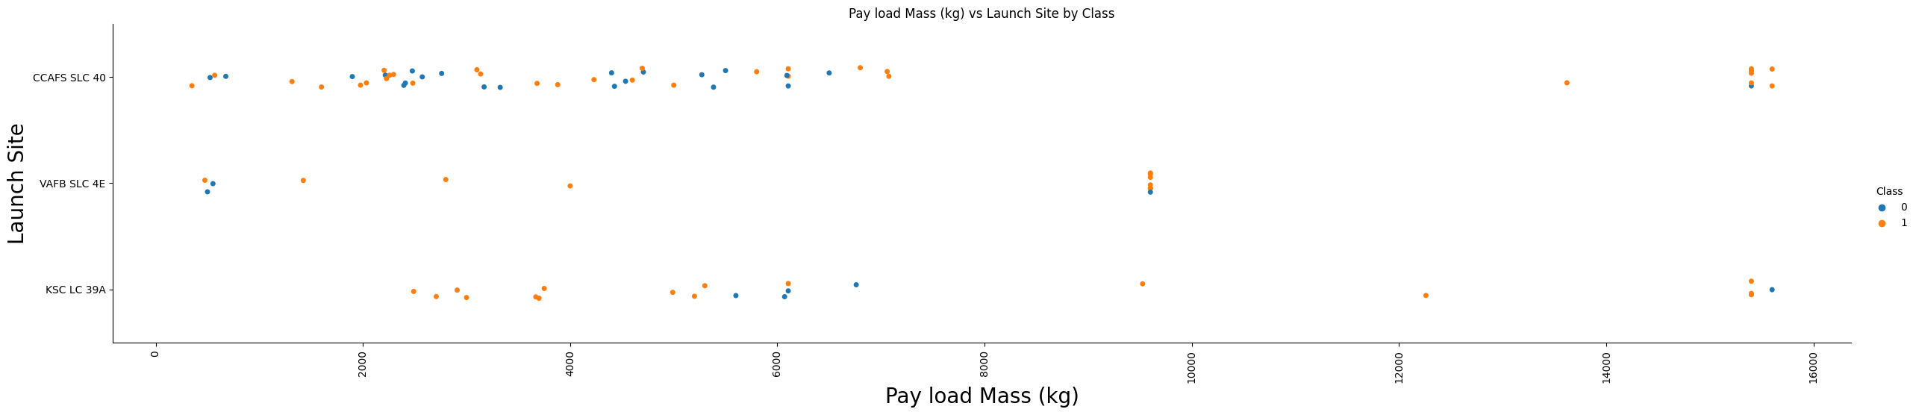
Payload vs. Launch Site
Result.
Varying Payload Masses: Launches have been conducted with a wide range of payload masses across all three launch sites.
Success at Higher Payloads: Particularly at KSC LC 39A, there are several successful launches (orange dots) at higher payload masses.
VAFB SLC 4E: This site has fewer launches compared to the others but shows a concentration of successful launches at lower payload masses. There are successful launches at higher payloads as well.
CCAFS SLC 40: Shows a mix of successes and failures across a wide range of payload masses.
Payload Mass vs. Launch Success: At higher payload masses, there seems to be a trend of increasing success (more orange dots), especially noticeable at KSC LC 39A.

Slide 18
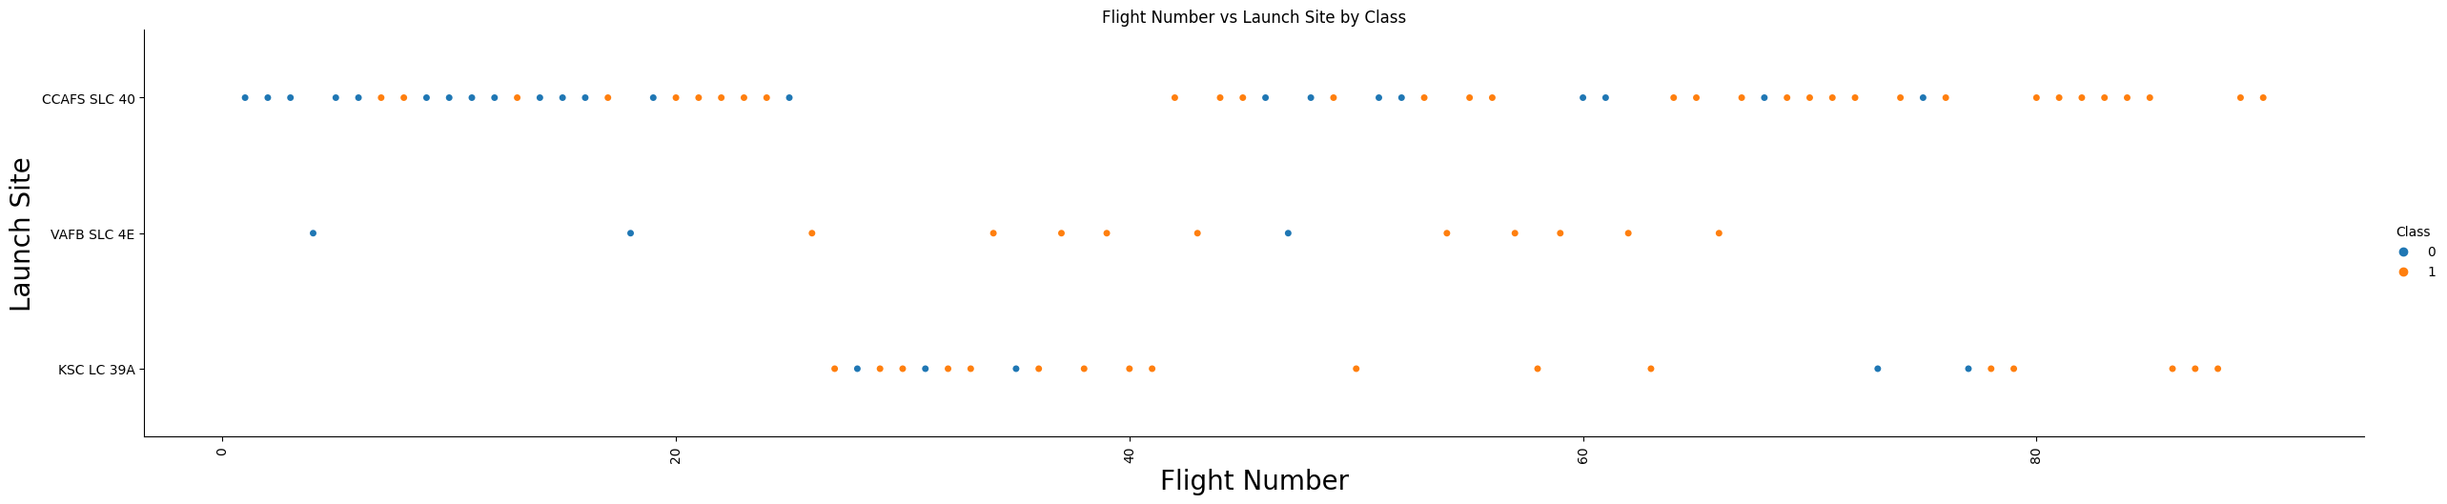
Flight Number vs. Launch Site
Results.
Blue points (Class 0) indicate unsuccessful launches.
Orange points (Class 1) indicate successful launches.
From the plot, we can make a few observations:
Over time, as the flight number increases, there seems to be a trend towards more successful launches, indicated by the density of orange points in the higher flight numbers.
The KSC LC 39A site has a cluster of successes after a certain flight number, suggesting an improvement in success rate over time.
VAFB SLC 4E shows fewer launches, but with a high success rate.
CCAFS SLC 40 has the most varied outcomes with a significant number of both successes and failures.

Slide 19
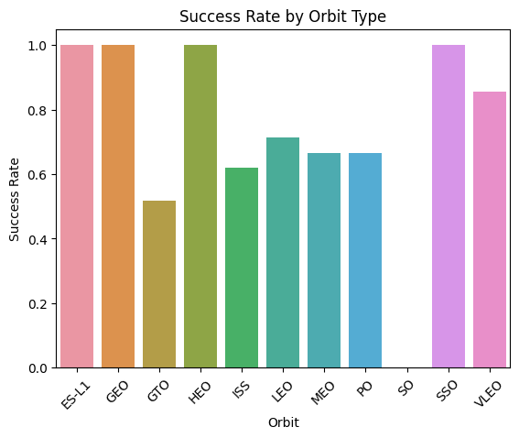
Success Rate vs. Orbit Type
High Success Rates: ES-L1, GEO, HEO and SSO orbits show very high success rates, close to or at 100%.
Moderate Success Rates: Orbits like ISS, LEO, and PO display moderate success rates ranging roughly from 60% to 80%.
Lower Success Rate: The GTO orbit has a noticeably lower success rate compared to other orbits.
Variability: There is a significant variability in success rates across different orbits, suggesting that some orbits may present more challenges or have different mission profiles and requirements affecting the success rates.
Perfect Success in Some Orbits: ES-L1, GEO, and SSO orbits suggest either a lower number of attempts or higher reliability and success in missions to these orbits.

Slide 20
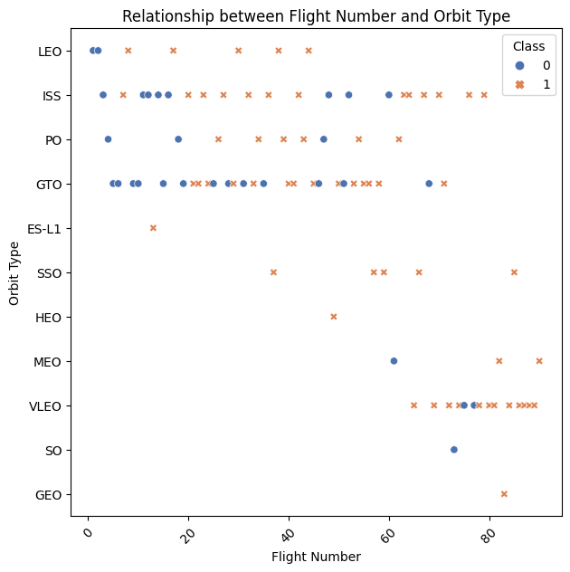
Flight Number vs. Orbit Type
In the GTO orbit, the distribution of orange and blue points throughout all flight numbers indicates a mix of successes and failures without a clear trend towards success with higher flight numbers.
The LEO orbit shows an interesting pattern with a cluster of successful launches at higher flight numbers, suggesting improved outcomes as experience or technology progresses.
The plot also includes less common orbits like ES-L1, SSO, HEO, MEO, VLEO, SO, and GEO, with varying degrees of success indicated.
Some orbits, such as ES-L1 and SSO, show only a few launches but with successful outcomes.
It's noticeable that some orbits (like MEO and GEO) have very few launches, which might indicate specific missions or less frequent launch requirements.

Slide 21
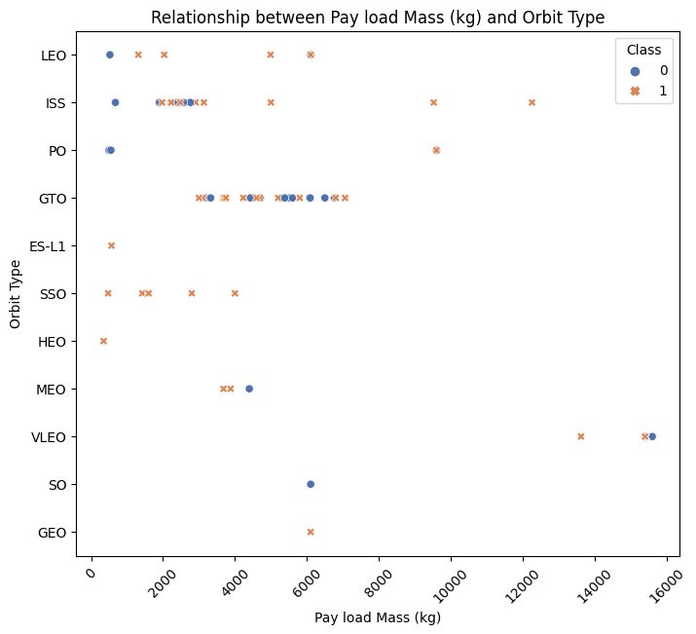
Payload vs. Orbit Type
For LEO and ISS orbits, successes are observed across a broad spectrum of payload masses, suggesting a robust performance in these orbits regardless of payload mass.
In contrast, the ES-L1, SSO, and HEO orbits show fewer launches, which might be specialized missions with specific payload requirements.
Notably, the scatter plot shows that higher payload masses (above 10,000 kg) are less common and tend to have a lower success rate (more blue points), particularly in GTO orbit, which could suggest the challenges of launching heavier payloads to higher orbits.
MEO and GEO orbits have very few data points, which may indicate less frequent launches or specialized missions with unique payload parameters.

Slide 22
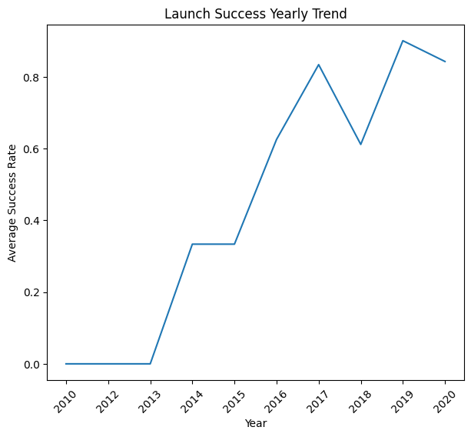
Launch Success Yearly Trend
The line chart shows the trend in launch success rates from 2010 to 2020. We observe a general increase in success over the years, with a notable dip in 2014. The peak in 2019 indicates a high success rate, which slightly decreases in 2020.

Slide 23
All Launch Site Names
The table presents a list of unique launch sites used for SpaceX missions.
The data shows four distinct locations:
CCAFS LC-40 (Cape Canaveral Air Force Station Launch Complex 40)
VAFB SLC-4E (Vandenberg Air Force Base Space Launch Complex 4E)
KSC LC-39A (Kennedy Space Center Launch Complex 39A)
CCAFS SLC-40 (This seems to be a repetition of the first entry and could potentially be a data entry duplication that may need verification or cleaning.)
Each of these sites has been used by SpaceX as a platform to launch spacecraft into orbit. The presence of multiple launch sites indicates a geographical diversity that can be strategic for reaching different orbits and for conducting launches under various conditions.
Launch Site
CCAFS LC-40
VAFB SLC-4E
KSC LC-39A
CCAFS SLC-40

Slide 24
Launch Site Names Begin with 'CCA'
The provided table details five SpaceX launch records, all from the Cape Canaveral Air Force Station (CCAFS) LC-40. The table highlights successful missions, some with landing attempts, others without. This indicates the progression of SpaceX's capabilities over time.
Date | Time (UTC) | Booster Version | Launch Site | Payload | PAYLOAD MASS (KG) | Orbit | Customer | Mission Outcome | Landing Outcome
2010-06-04 | 18:45:00 | F9 v1.0 B0003 | CCAFS LC-40 | Dragon Spacecraft Qualification Unit | 0 | LEO | SpaceX | Success | Failure (parachute)
2010-12-08 | 15:43:00 | F9 v1.0 B0004 | CCAFS LC-40 | Dragon demo flight C1, two CubeSats, barrel of Brouere cheese | 0 | LEO (ISS) | NASA (COTS) NRO | Success | Failure (parachute)
2012-05-22 | 7:44:00 | F9 v1.0 B0005 | CCAFS LC-40 | Dragon demo flight C2 | 525 | LEO (ISS) | NASA (COTS) | Success | No attempt
2012-10-08 | 0:35:00 | F9 v1.0 B0006 | CCAFS LC-40 | SpaceX CRS-1 | 500 | LEO (ISS) | NASA (CRS) | Success | No attempt
2013-03-01 | 15:10:00 | F9 v1.0 B0007 | CCAFS LC-40 | SpaceX CRS-2 | 677 | LEO (ISS) | NASA (CRS) | Success | No attempt

Slide 25
Total Payload Mass
The total payload mass carried by boosters from NASA is 45,596 kg. This figure represents the cumulative mass of all payloads that NASA has launched using boosters, which can include satellites, science experiments, and other cargo necessary for missions. The payload mass is a critical factor in launch planning as it affects the rocket's trajectory, fuel requirements, and overall mission success.
Total Payload Mass
45596

Slide 26
Average Payload Mass by F9 v1.1
The average payload mass carried by the booster version F9 v1.1 is 2,928.4 kg. This average is calculated from all launches that used the F9 v1.1 booster variant, indicating the typical mass that this version has been capable of transporting to its designated orbit. The F9 v1.1 is one of the iterations of the Falcon 9 launch vehicle, and its payload capacity is an important measure of its performance and capability for various types of missions.
Average Payload Mass
2928.4

Slide 27
First Successful Ground Landing Date
The first successful landing outcome on a ground pad occurred on December 22, 2015. This milestone signifies a significant achievement for SpaceX, marking the first time the company managed to return a rocket's first stage to a ground-based landing site post-launch for potential reuse.
This event is crucial in the history of space exploration as it demonstrates the feasibility of recycling rocket components, a strategy that can significantly reduce the cost of access to space.
First Successful Ground Pad Landing
2015-12-22

Slide 28
Successful Drone Ship Landing with Payload between 4000 and 6000
The query results list the booster versions that have successfully landed on a drone ship and had a payload mass greater than 4000 kg but less than 6000 kg.
These specific booster versions represent successful missions where SpaceX not only managed to deliver a medium-heavy payload to the designated orbit but also achieved a successful landing on a drone ship, showcasing their capability for booster reusability.
This is a significant step in space missions as it demonstrates precision in both payload delivery and landing techniques, contributing to cost-effectiveness and sustainability in space exploration.
Booster Version
F9 FT B1022
F9 FT B1026
F9 FT B1021.2
F9 FT B1031.2

Slide 29
Total Number of Successful and Failure Mission Outcomes
The query results show that there have been a total of 98 successful mission outcomes, 1 failure (in flight), and 2 additional successes with some caveats—one where the payload status was unclear, and another not further specified.
This data indicates a high success rate for the missions, with the vast majority achieving their intended outcomes.
The single recorded in-flight failure represents a rare exception to the overall trend of successful missions.
The success rate is a testament to the effectiveness and reliability of the mission planning and execution.
Mission Outcome | Total
Failure (in flight) | 1
Success | 98
Success | 1
Success (payload status unclear) | 1

Slide 30
Boosters Carried Maximum Payload
Booster Version
F9 B5 B1048.4
F9 B5 B1049.4
F9 B5 B1051.3
F9 B5 B1056.4
F9 B5 B1048.5
F9 B5 B1051.4
F9 B5 B1049.5
F9 B5 B1060.2
F9 B5 B1058.3
F9 B5 B1051.6
F9 B5 B1060.3
F9 B5 B1049.7
These versions of the Falcon 9 Block 5 boosters have carried the maximum payload mass on their respective missions.
This information is valuable as it indicates the boosters that have been optimized for heavy payload delivery, a crucial factor for certain types of missions that require the transport of large and heavy satellites or supplies to space.
The repeated appearance of the Block 5 variant suggests that it has been designed to enhance payload capacity, which aligns with SpaceX's goals for reusability and cost-effective space transport.
This capability is a significant aspect of SpaceX's competitive edge in the commercial spaceflight market.

Slide 31
2015 Launch Records
month | Landing Outcome | Booster Version | Launch Site
01 | Failure (drone ship) | F9 v1.1 B1012 | CCAFS LC-40
04 | Failure (drone ship) | F9 v1.1 B1015 | CCAFS LC-40
The query result shows two failed landing outcomes in the year 2015 on a drone ship, including the details of their booster versions and launch site names. Specifically, the failed attempts were associated with:
These outcomes highlight the challenges faced during the attempts to land the Falcon 9 first stages on autonomous spaceport drone ships (ASDS) in the early stages of developing reusable rocket technology.
Each failed attempt provided SpaceX with valuable data to improve their technology, ultimately leading to the successful landings that are more commonplace in their missions today. The launch site CCAFS LC-40 is noted as the departure point for these missions, marking its significance in SpaceX's operational history.

Slide 32
Rank Landing Outcomes Between 2010-06-04 and 2017-03-20
The query result provides a ranked list of landing outcomes for SpaceX missions between June 4, 2010, and March 20, 2017, sorted in descending order based on the frequency of each outcome:
No attempt: There were 10 instances where no landing attempt was made.
Success (drone ship): 5 successful landings were made on a drone ship.
Failure (drone ship): There were also 5 instances where attempts to land on a drone ship failed.
Success (ground pad): 3 landings on ground pads were successful.
Controlled (ocean): There were 3 controlled landings in the ocean, which likely means the booster was intentionally guided to a soft landing in the water.
Uncontrolled (ocean): 2 landings in the ocean were uncontrolled, indicating a less favorable outcome where the booster may have crashed into the water.
Failure (parachute): There were 2 failures related to the parachute system, which is part of the landing process.
Precluded (drone ship): In 1 instance, a drone ship landing was precluded, which could mean that the landing was called off or not attempted for some reason.
Landing Outcome | Total Outcomes
No attempt | 10
Success (drone ship) | 5
Failure (drone ship) | 5
Success (ground pad) | 3
Controlled (ocean) | 3
Uncontrolled (ocean) | 2
Failure (parachute) | 2
Precluded (drone ship) | 1

Slide 33

Section 3

Slide 34
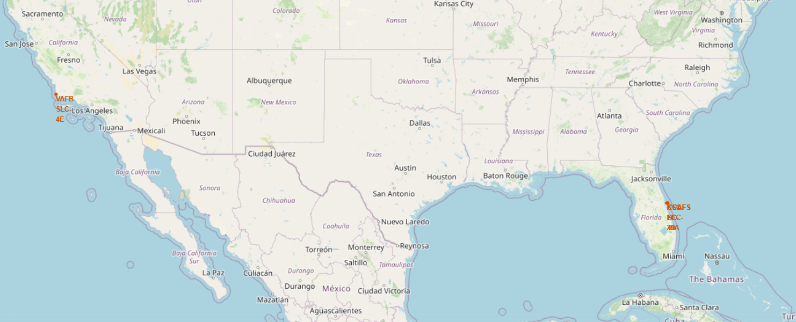
Folium Map Showing the locations of SpaceX launch sites
SpaceX Launch Sites Overview
Coastal Locations: All sites near coastlines for launch safety and debris management.
Equatorial Advantage: Proximity to the equator at some sites aids in orbital velocity.
Nationwide Presence: Sites span from East (Florida) to West (California) Coast, showing national coverage.
Strategic Positioning: Sites chosen for optimal launch conditions and trajectory efficiency.

Slide 35
Folium Map Showing the locations of SpaceX launch sites
SpaceX Launch Sites Overview
Coastal Locations: All sites near coastlines for launch safety and debris management.
Equatorial Advantage: Proximity to the equator at some sites aids in orbital velocity.
Nationwide Presence: Sites span from East (Florida) to West (California) Coast, showing national coverage.
Strategic Positioning: Sites chosen for optimal launch conditions and trajectory efficiency.

Slide 36
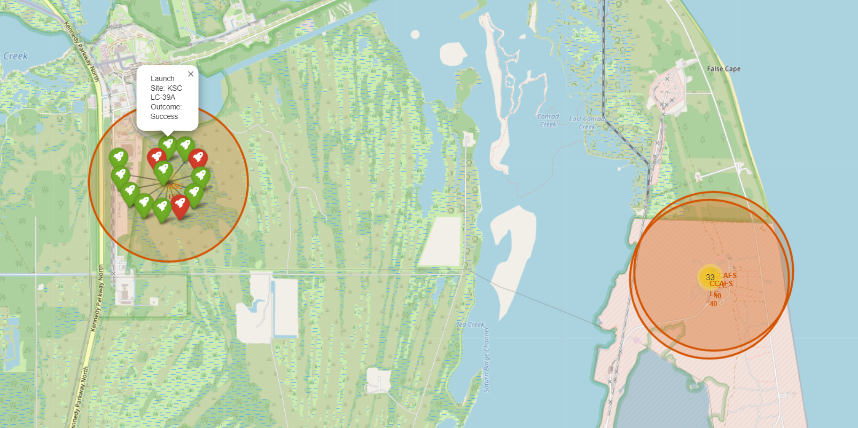
Folium Map Showing Successful/failed launches for each site on the map
Launch Outcome Analysis at Kennedy Space Center
Visual Indicator: Red and green markers denote failed and successful launches, respectively.
Clustered Outcomes: A concentration of markers shows a history of launch attempts.
Success Correlation: Proximity to the coast may correlate with higher success rates due to clear flight paths and safe landing zones.
Strategic Insights: The clustering of green markers suggests a trend of increasing success over time at this site.

Slide 37
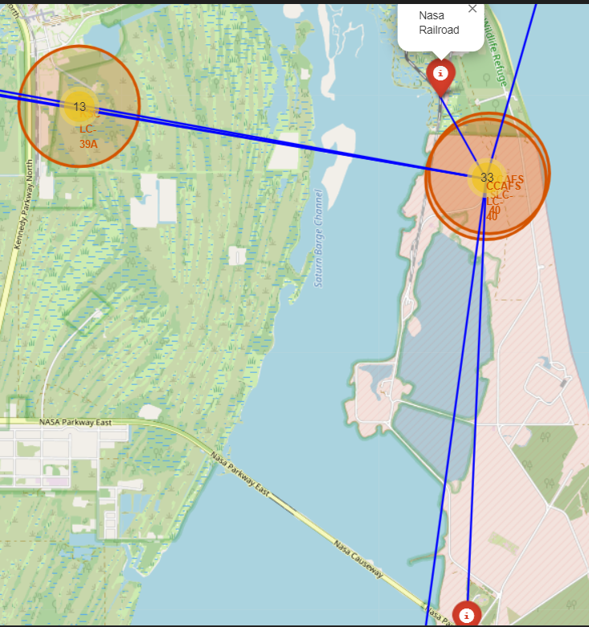
Folium Map Showing Proximity of Launch Site to Infrastructure
Key Elements: Lines connecting launch site to railway, highway, and coastline.
Distance Measurement: Blue lines indicate measured distances showcasing strategic location choices for the launch site.
Infrastructure Insights: Proximity to railways and highways facilitates transportation and logistics efficiency, while closeness to the coastline allows for safer launch trajectories and potential landing zones.
Geographical Advantage: The site's location is likely chosen for optimal access to necessary infrastructure while maintaining safety standards for launch and landing operations.

Slide 38

Section 4

Slide 39
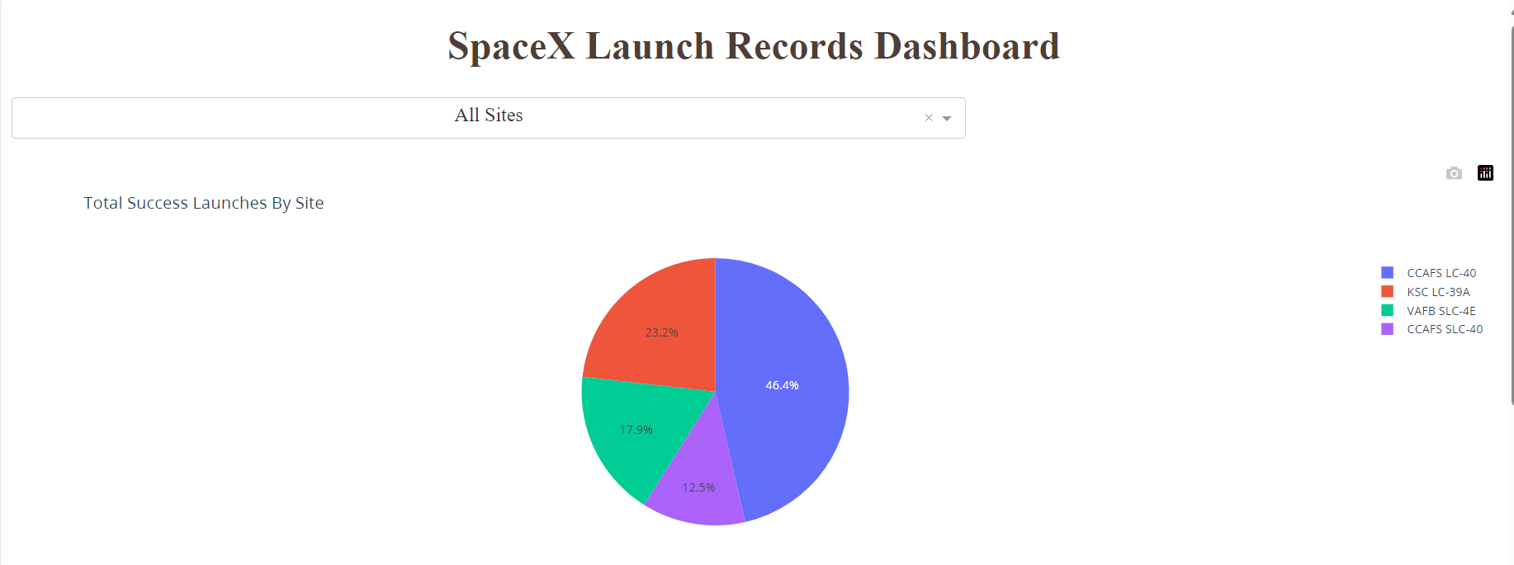
Plotly Dashboard Showing Success Distribution
Launch Success Distribution by Site
Dashboard Element: Pie chart visualizing the proportion of total successful launches from different SpaceX sites.
Key Insights:
The majority of successful launches originate from the CCAFS LC-40 site.
KSC LC-39A follows as the second most frequent site for successful launches.
The VAFB SLC-4E and CCAFS SLC-40 sites contribute less to the overall success rate.
Strategic Importance: The visualization highlights the significance of each launch site in SpaceX's operational success and may guide future infrastructure and resource allocation.

Slide 40
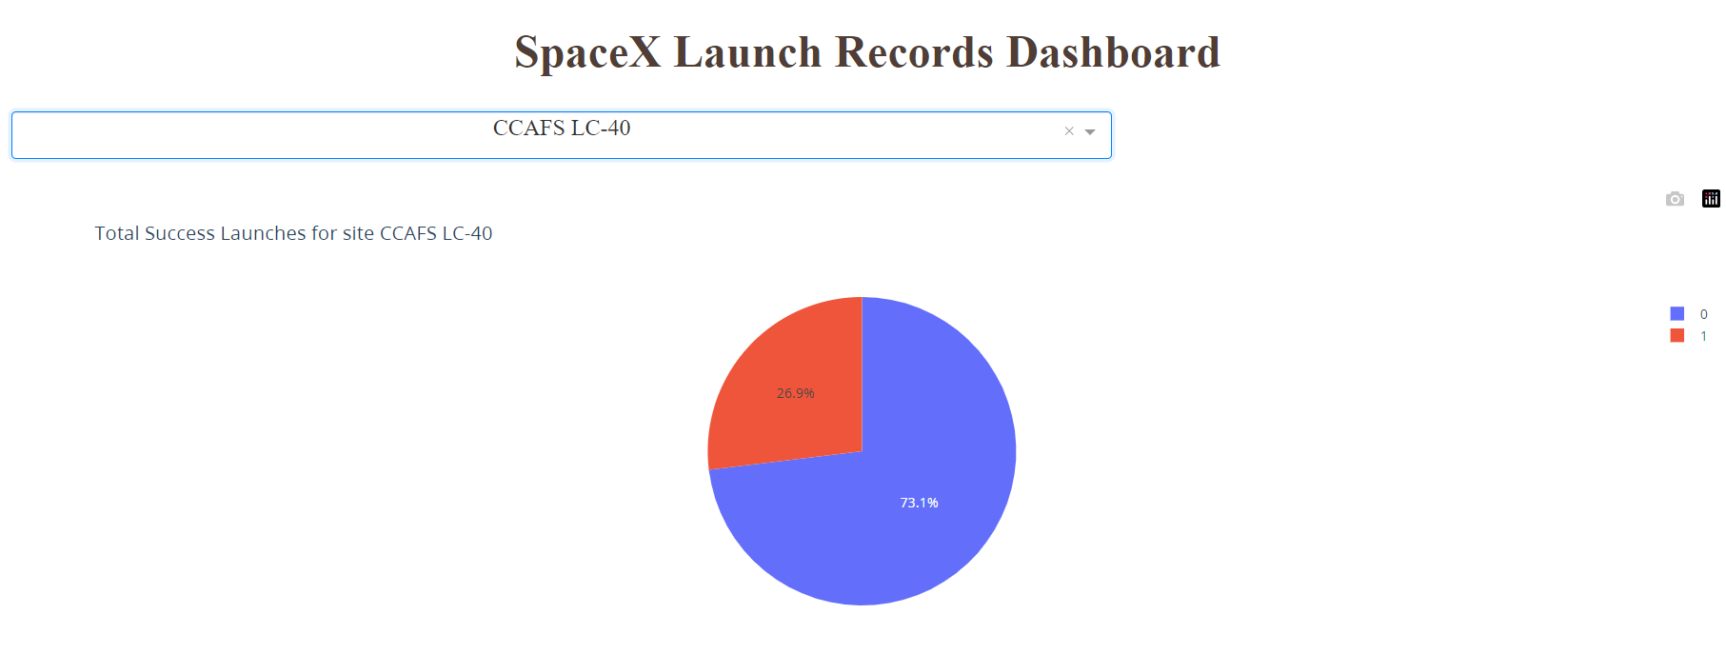
Plotly Dashboard Showing Success Distribution of the Highest Site
Success Ratio at CCAFS LC-40 Launch Site
Dashboard Feature: Pie chart illustrating the success ratio of launches at the CCAFS LC-40 site.
Key Insights:
The vast majority (73.1%) of launches from the CCAFS LC-40 site have been successful.
A significant minority (26.9%) of launches have not been successful, indicating room for improvement and analysis.
Strategic Implications: Understanding the factors behind the unsuccessful launches can drive improvements in future missions, ensuring higher success rates and reliability.

Slide 41
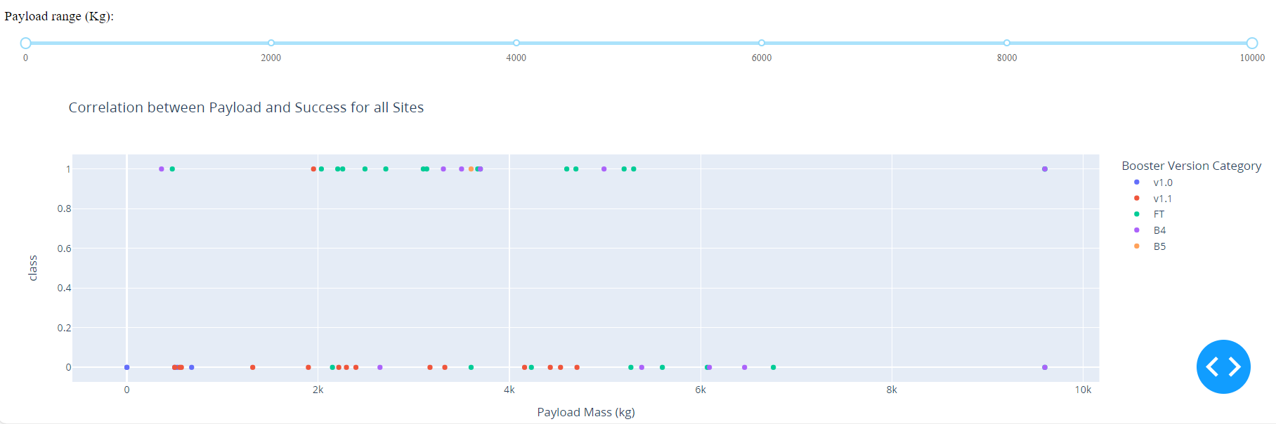
Plotly Dashboard Showing Payload vs. Launch Outcome scatter plot
Payload vs. Launch Outcome Correlation
Dashboard Feature: Interactive scatter plot showing the correlation between payload mass and launch success for all sites.
Key Insights:
Launch outcomes are evenly distributed across different booster versions.
Success rate is consistent across a wide range of payload masses, indicating robust performance.
The majority of failures occur with lower payload masses, particularly under 2000 kg.
Strategic Implications: This suggests that factors other than payload mass are more critical to launch success and should be the focus of further analysis.

Slide 42

Section 5

Slide 43
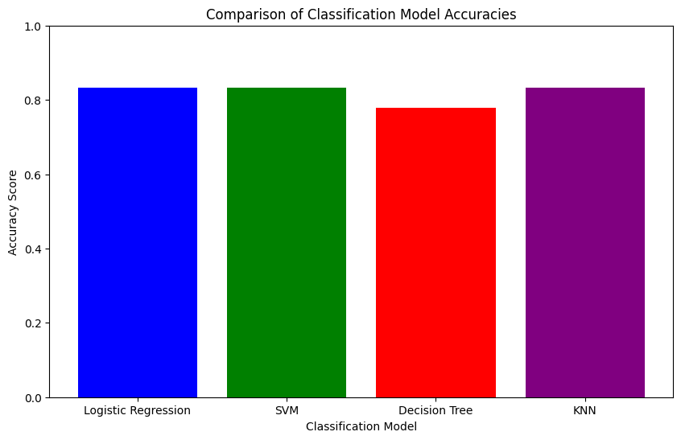
Classification Accuracy
The bar chart illustrates the accuracy of four different classification models, highlighting which model achieved the highest score.
Key insights
The Logistic Regression Logistic Regression model shows the highest accuracy among the evaluated models.
KNN and SVM demonstrate comparable performance.
"Decision Tree has a lower accuracy compared to the other models.

Slide 44

Confusion Matrix
Confusion Matrix of the Best Performing Model
The model has a high number of true positives (12), indicating strong predictive accuracy for successful landings.
It correctly identified all actual landings (no false negatives).
There were 3 instances each of false positives and true negatives, suggesting some room for improvement in predicting unsuccessful landings.
The model shows no errors in over-predicting unsuccessful landings, as indicated by the zero false negatives.

Slide 45
Conclusions
SpaceX launch data reveals a strong correlation between launch site location and success rates, with coastal proximity being advantageous.
Analysis indicates a higher likelihood of successful landings with increasing flight numbers, suggesting improvements in technology and experience.
Machine learning models can effectively predict first-stage landings with significant accuracy, aiding in cost estimations.
The developed interactive dashboards provide valuable insights into launch outcomes, assisting strategic decision-making.
Payload mass has a notable impact on launch success, with lighter payloads demonstrating a higher success ratio.
The F9 booster series, particularly the B5 variant, is identified as the most successful in terms of payload to orbit delivery.
Data-driven approaches can significantly reduce costs and increase the reliability of space missions, thereby accelerating the commercial space industry's growth.

Slide 46
Appendix
Include any relevant assets like Python code snippets, SQL queries, charts, Notebook outputs, or data sets that you may have created during this project

Slide 47


